Slide 1



Concurrency
(Part 2)

Slide 2
Objectives
Monitors, Waiting, and Notifying
  The Object Lock and Synchronization
  wait() and notify()
  The Class Lock
  notifyAll()
  Deadlock
  Synchronizing Part of a Method

Slide 3
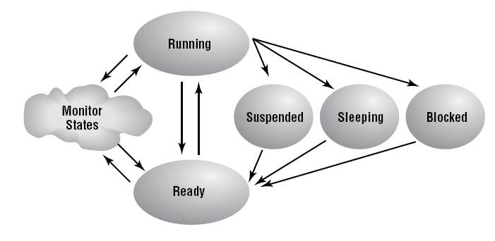
Thread: Living states

Slide 4
Monitor concept
One of the strengths of the Java programming language is its support for multithreading at the language level. Much of this support centers on synchronization: coordinating activities and data access among multiple threads. The mechanism that Java uses to support synchronization is the monitor.
A monitor is like a building that contains one special room that can be occupied by only one thread at a time. The room usually contains some data. From the time a thread enters this room to the time it leaves, it has exclusive access to any data in the room. Entering the monitor building is called "entering the monitor." Entering the special room inside the building is called "acquiring the monitor." Occupying the room is called "owning the monitor," and leaving the room is called "releasing the monitor." Leaving the entire building is called "exiting the monitor."

Slide 5
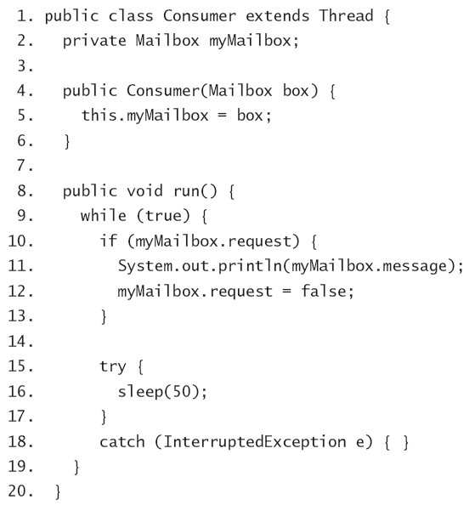
What is the reason for having monitors?
On a time-sliced system, the consumer thread could just possibly be interrupted
between lines 10 and 11

Slide 6
Monitors, Waiting, and Notifying
Java’s monitor support addresses these issues by providing the following resources:
  A lock for each object
  The synchronized keyword for accessing an object’s lock.
  The wait(), notify(), and notifyAll() methods, which allow the object to control client threads.
  These methods can be called only in synchronized code.

Slide 7
The Object Lock and Synchronization
The lock controls access to the object’s synchronized code.
A thread that wants to execute an object’s synchronized code must first attempt to acquire that object’s lock.
  If the lock is available: all is well
  If the lock is under another thread’s control: goes in to Seeking Lock state.

Slide 8
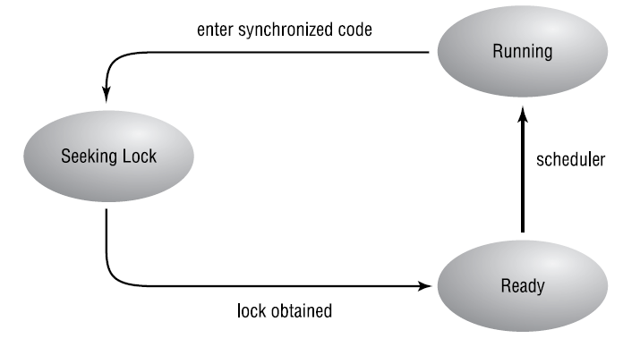
The Seeking Lock state

Slide 9
synchronized keyword
You can mark code as synchronized two ways:
Synchronize an entire method.
  To execute the method, a thread must acquire the lock of the object that owns the method.
Synchronize a subset of a method
  synchronized(someObject) { }

Slide 10
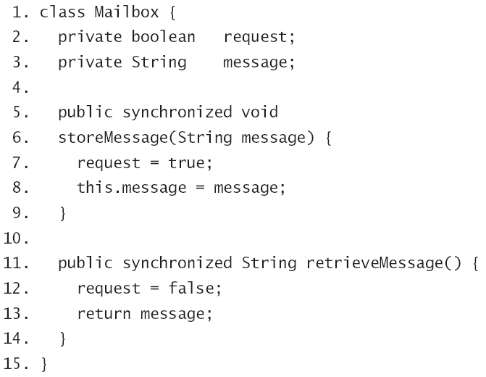
synchronized sample

Slide 11
wait() and notify()
wait() and notify() are methods of Object class.
A call to wait/notify must be within synchronized code. Otherwise Runtime error, an exception will be thrown
wait() methods provide a way for a shared object to pause a thread when it becomes unavailable to that thread.
notify() methods provide a way for a shared object to allow the thread to continue when appropriate.
With wait and notify the threads themselves never have to check the state of the shared object

Slide 12
wait() and notify()…
The wait() and notify() methods provide a way for a shared object to pause a thread when it becomes unavailable to that thread and to allow the thread to continue when appropriate.
The threads themselves never have to check the state of the shared object.
An object that controls its client threads in this manner is known as a monitor. In strict Java terminology, a monitor is any object that has some synchronized code. Any such object has the infrastructure needed to allow it to block and revive threads. To be really useful, most monitors make use of wait() and notify() methods.

Slide 13
wait()
The calling thread gives up the CPU.
The calling thread gives up the lock.
The calling thread goes into the monitor’s waiting pool.

Slide 14
notify()
One arbitrarily chosen thread gets moved out of the monitor’s waiting pool and into the Seeking Lock state.
The thread that was notified must reacquire the monitor’s lock before it can proceed.

Slide 15
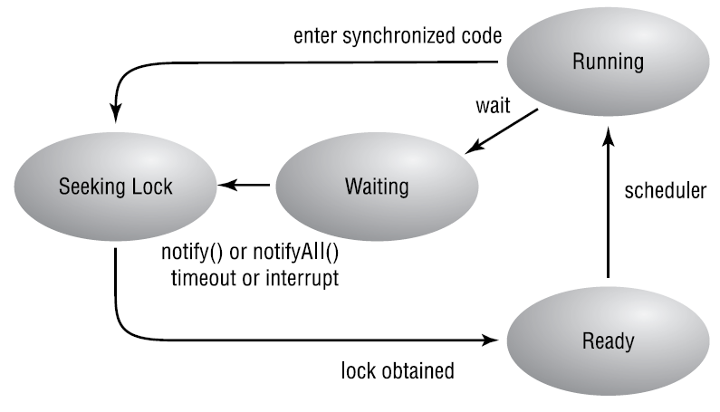
The monitor states

Slide 16
wait() and notify() example
class Mailbox
{ private boolean request;
private String message;
public synchronized void storeMessage(String message)
{ while(request == true)
{// No room for another message
try { wait(); } catch (InterruptedException e) { }
}
request = true;
this.message = message;
notify();
}
public synchronized String retrieveMessage()
{ while(request == false)
{ // No message to retrieve
try { wait(); } catch (InterruptedException e) { }
}
request = false;
notify();
return message;
}
}
To briefly summarize this scenario: a consumer tried to consume something (call retrieveMessage() function), but there was nothing to consume, so the consumer waited. Later a producer produced something. At that point there was something for the consumer to consume, so the consumer was notified; once the producer was done with the monitor, the consumer consumed a message.

Slide 17
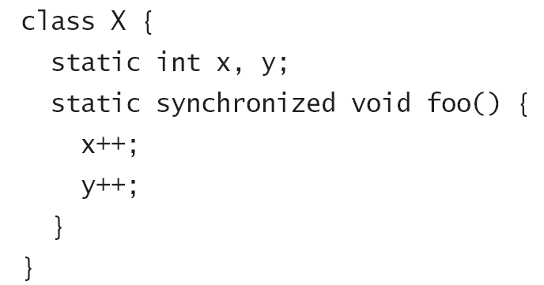
The Class Lock
Every object has a lock
Every class also has a lock
  The class lock controls access to all synchronized static code in the class.

Slide 18
notifyAll()
Wakes up all threads that are waiting on this object's monitor

Slide 19
Deadlock
If a thread blocks because it is waiting for a condition, and something else in the program makes it impossible for that condition to arise, then the thread is said to be deadlocked.

Slide 20
Synchronizing Part of a Method
To synchronize an entire method, using the lock of the object that owns the method. To do this, put the synchronized keyword in the method’s declaration.
To synchronize part of a method, using the lock of an arbitrary object. Put { } around the code to be synchronized, preceded by synchronized(theArbitraryObject).
To synchronize part of a method, using the lock of the object that owns the method. Put { } around the code to be synchronized, preceded by synchronized(this).

Slide 21
Synchronizing Part of a Method…
class StrangeSync {
Rectangle rect = new Rectangle(11, 13, 1100, 1300);
void doit() {
int x = 504;
int y = x / 3;
synchronized(rect) {
rect.width -= x;
rect.height -= y;
}
}
}

Slide 22
Summary
  The Object Lock and Synchronization
  wait() and notify()
  The Class Lock
  notifyAll()
  Deadlock
  Synchronizing Part of a Method
Q&A

